Slide 1
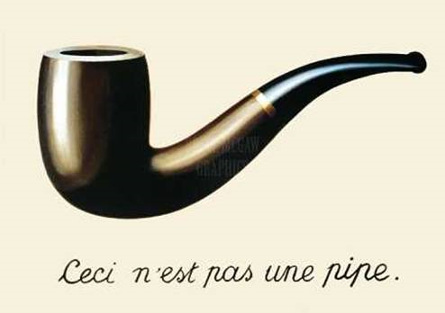
Pictures and Words

Slide 2
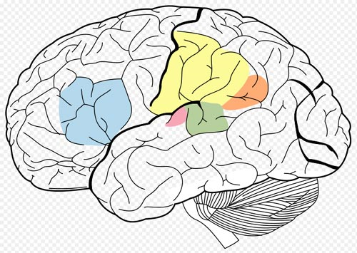
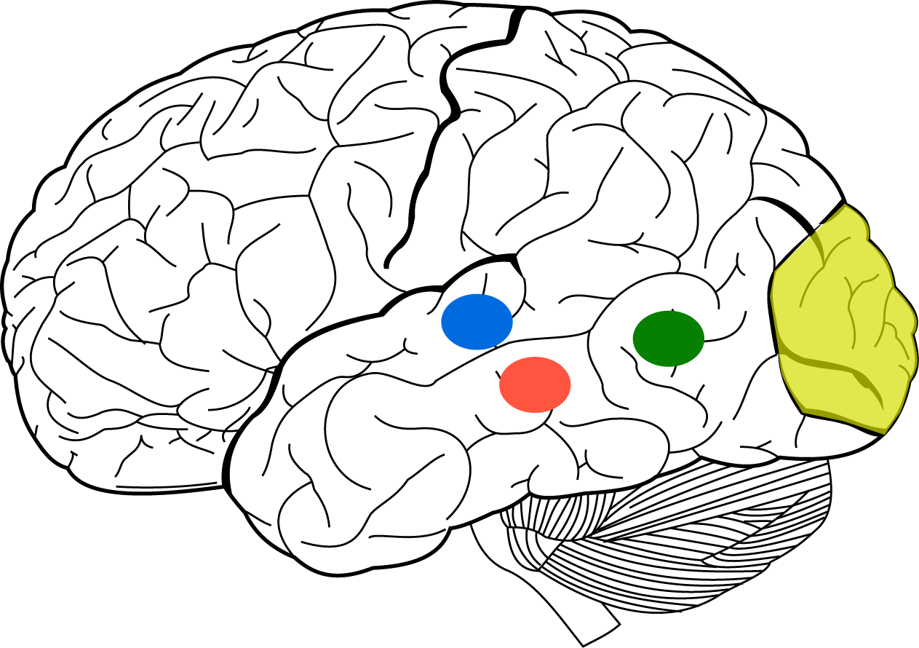

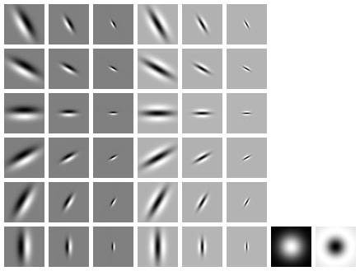
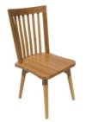

Vision and language in human brain
Language
Vision
Wernicke
Area
Broca
Area
PPA
LOC
V1
FFA

Slide 3
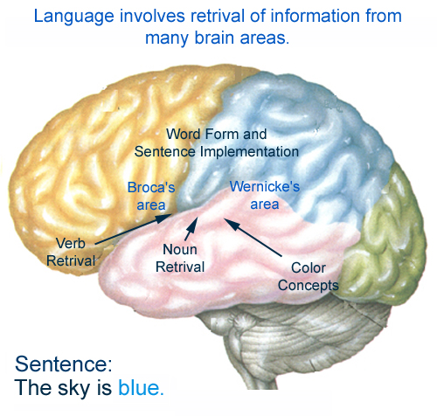

Vision and language in human brain
figure modified from: http://www.colorado.edu/intphys/Class/IPHY3730

Slide 4
Vision and language in human brain
?
(Translation: “This is not a pipe.”)
figure modified from: http://www.colorado.edu/intphys/Class/IPHY3730

Slide 5

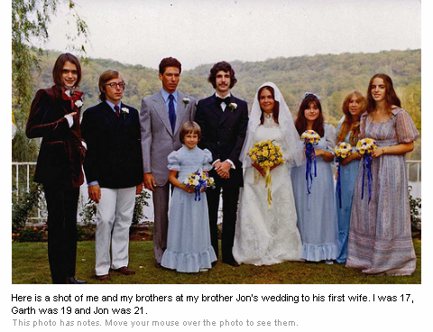

Slide 6


Slide 7

What can you see in a glance of a scene?
Fei-Fei, Iyer, Koch, Perona, JoV, 2007

Slide 8
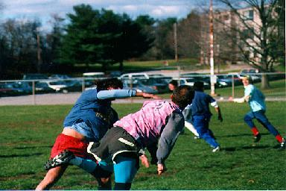
PT = 27ms
This was a picture with some dark sploches in it. Yeah. . .that's about it. (Subject: KM)
PT = 40ms
I think I saw two people on a field. (Subject:
RW)
PT = 67ms
Outdoor scene. There were some kind of animals, maybe dogs or horses, in the middle of the picture. It looked like they were running in the middle of a grassy field. (Subject: IV)
PT = 500ms
Some kind of game or fight. Two groups of two men? The foregound pair looked like one was getting a fist in the face. Outdoors seemed like because i have an impression of grass and maybe lines on the grass? That would be why I think perhaps a game, rough game though, more like rugby than football because they pairs weren't in pads and helmets, though I did get the impression of similar clothing. maybe some trees? in the background. (Subject: SM)
PT = 107ms
two people, whose profile was toward me. looked like they were on a field of some sort and engaged in some sort of sport (their attire suggested soccer, but it looked like there was too much contact for that). (Subject: AI)
Fei-Fei, Iyer, Koch, Perona, JoV, 2007

Slide 9
Section outline
Early “pictures and words” work
Content-based retrieval
Beyond nouns, towards total scene annotation

Slide 10
“Pictures and words”
Barnard, Duygulu, de Freitas, Forsyth, Blei, Jordan, Matching words and pictures, JMLR, 2003
Duygulu, Barnard, de Freitas, Forsyth, Object Recognition as Machine Translation: Learning a lexicon for a fixed image vocabulary , ECCV, 2003
Blei & Jordan, Modeling annotated data, ACM SIGIR, 2003
Chang, Goh, Sychay, & Wu, Soft annotation using Bayes point machines, IEEE Transactions on Circuits and Systems for Video Technology, 2003
Goh, Chang, & Cheng, Ensemble of SVM-based classifiers for annotation, 2003
….

Slide 11

Images are composed of multimodal “concepts”.
Images are clustered based on priors over concepts.
Learning determines localized concepts models from global annotations.
Addresses the correspondence problem
One possible assumption: concept models simultaneously generate both a word and blob
sun
sun
sky
water
waves
Slide courtesy of Kobus Barnard (1 hour ago!)
Barnard et al. JMLR, 2005

Slide 12
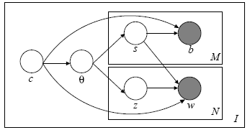
A generative model for assembling image data sets from multimodal clusters
Chose an image cluster by p(c)
Chose multimodal concept clusters using p(s|c)
From each multimodal cluster, sample a Gaussian for blob features, p(b|s), and a multinomial for words, p(w|s)
(Skip with some probability to account for mismatched numbers of words and blobs)
For a given correspondence*
sun
sun
sky
water
waves
Slide courtesy of Kobus Barnard (1 hour ago!)
Barnard et al. JMLR, 2005

Slide 13
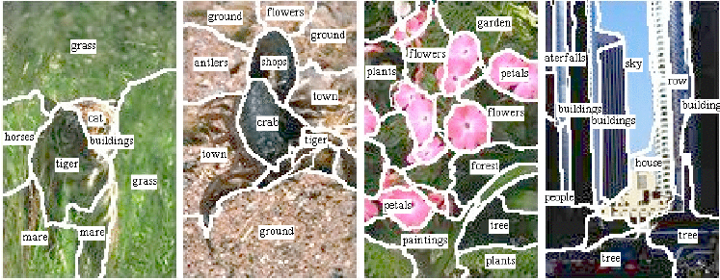
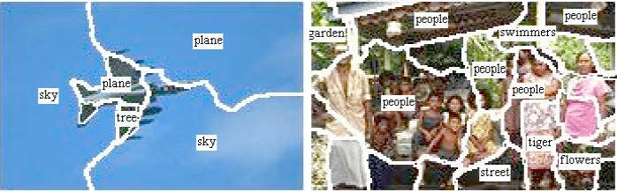
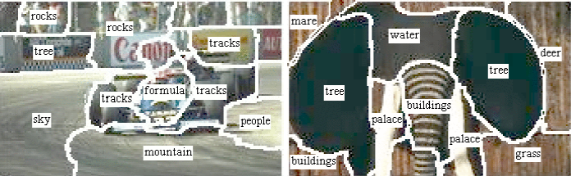
Barnard et al. JMLR, 2005

Slide 14
Section outline
Early “pictures and words” work
Content-based retrieval
Beyond nouns, towards total scene annotation

Slide 15
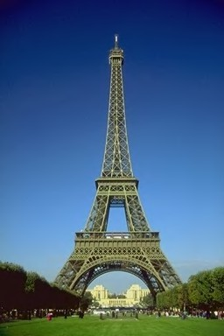

Content-based retrieval
Elegance
Love
Symmetry
Petals
Flower
Tower
France
Corolla
Rose
Australian Floribunda Rose
Eiffel Tower
Paris
Slide courtesy of Ritendra Datta, Jia Li, James Z. Wang

Slide 16
Literature – MANY!!!
A. W. Smeulders, M. Worring, S. Santini, A. Gupta, R. Jain, Content-Based Image Retrieval at the End of the Early Years, IEEE Trans. Pattern Analysis and Machine Intelligence , 22(12):1349-1380, 2000.
R. Datta, D. Joshi, J. Li, and J. Z. Wang, Image Retrieval: Ideas, Influences, and Trends of the New Age, ACM Computing Surveys, vol. 40, no. 2, pp. 5:1-60, 2008.

Slide 17
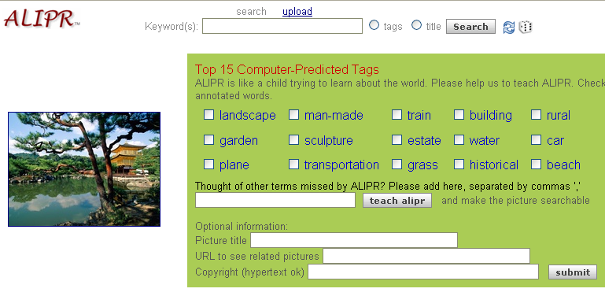
Try out Alipr (www.alipr.com)

Slide 18
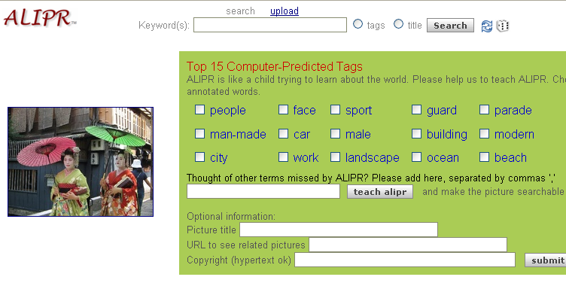
Try out Alipr (www.alipr.com)

Slide 19
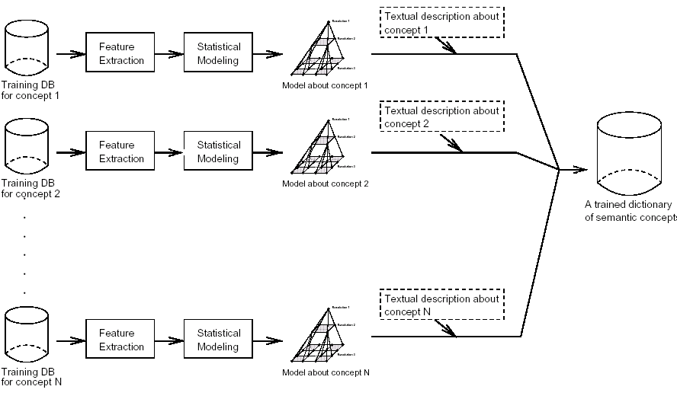
Automatic Image Annotation: ALIP
Slide courtesy of Ritendra Datta, Jia Li, James Z. Wang

Slide 20
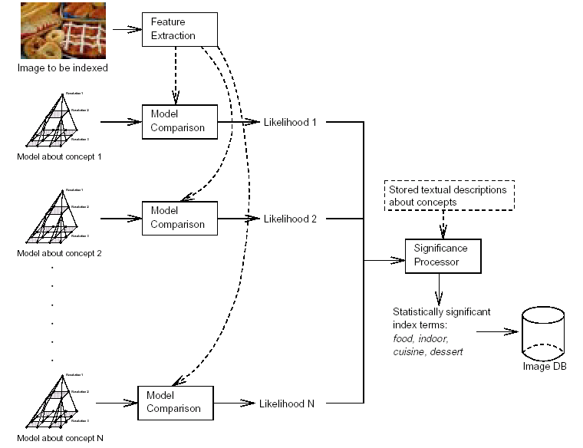
Automatic Image Annotation: ALIP
Slide courtesy of Ritendra Datta, Jia Li, James Z. Wang

Slide 21
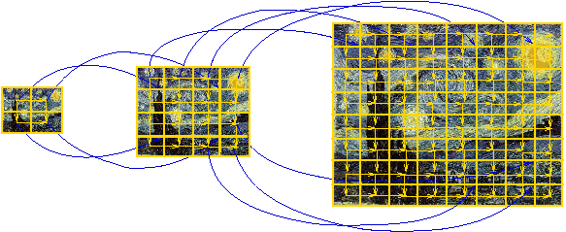
Automatic Image Annotation: ALIP
2D-MHMM: Two-dimensional multi-resolution hidden Markov model
Slide courtesy of Ritendra Datta, Jia Li, James Z. Wang

Slide 22
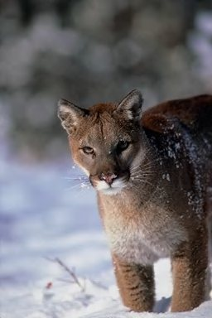
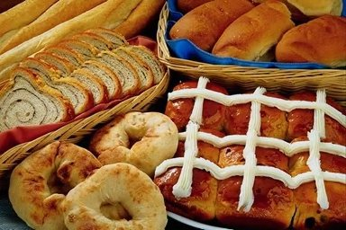
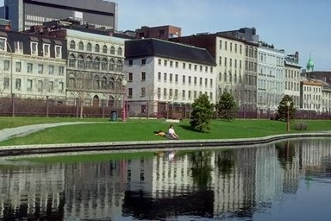
Automatic Image Annotation: ALIP
Annotation Process
Classification results form the basis
Salient words appearing in the classification favored more
Food, indoor, cuisine, dessert
Building, sky, lake, landscape, Europe, tree
Snow, animal, wildlife, sky, cloth, ice, people
Slide courtesy of Ritendra Datta, Jia Li, James Z. Wang

Slide 23
Section outline
Early “pictures and words” work
Content-based retrieval
Beyond nouns, towards total scene annotation
Propositions
A. Gupta and L. S. Davis, Beyond Nouns: Exploiting prepositions and comparative adjectives for learning visual classifiers, ECCV, 2008
Objects, scenes, activities
L.-J. Li and L. Fei-Fei. What, where and who? Classifying event by scene and object recognition. ICCV, 2007
L.-J. Li, R. Socher and L. Fei-Fei. Towards Total Scene Understanding:Classification, Annotation and Segmentation in an Automatic Framework. CVPR, 2009

Slide 24
Section outline
Early “pictures and words” work
Content-based retrieval
Beyond nouns, towards total scene annotation
Propositions
A. Gupta and L. S. Davis, Beyond Nouns: Exploiting prepositions and comparative adjectives for learning visual classifiers, ECCV, 2008
Objects, scenes, activities
L.-J. Li and L. Fei-Fei. What, where and who? Classifying event by scene and object recognition. ICCV, 2007
L.-J. Li, R. Socher and L. Fei-Fei. Towards Total Scene Understanding:Classification, Annotation and Segmentation in an Automatic Framework. CVPR, 2009

Slide 25
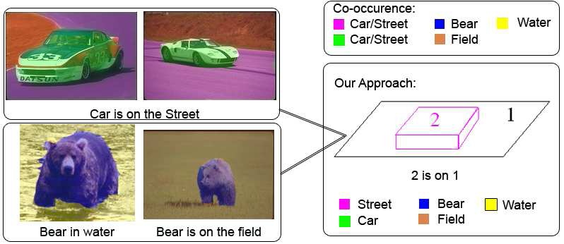
“Beyond nouns”
Gupta & Davis, EECV, 2008

Slide 26
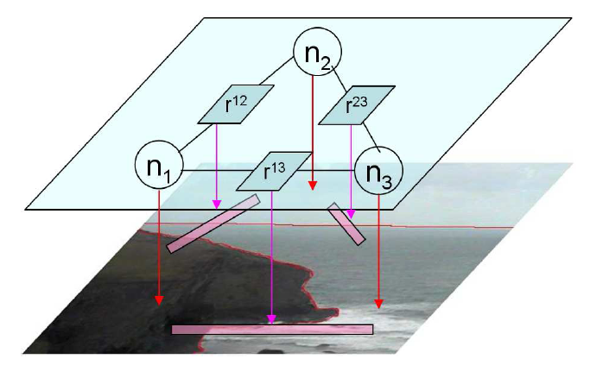
“Beyond nouns”
Gupta & Davis, EECV, 2008

Slide 27
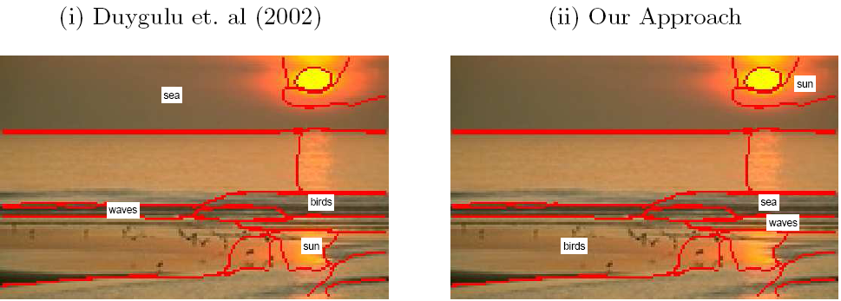
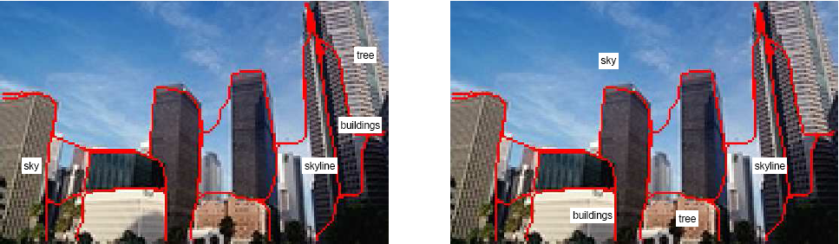
Gupta & Davis, EECV, 2008

Slide 28
Section outline
Early “pictures and words” work
Content-based retrieval
Beyond nouns, towards total scene annotation
Propositions
A. Gupta and L. S. Davis, Beyond Nouns: Exploiting prepositions and comparative adjectives for learning visual classifiers, ECCV, 2008
Objects, scenes, activities
L.-J. Li and L. Fei-Fei. What, where and who? Classifying event by scene and object recognition. ICCV, 2007
L.-J. Li, R. Socher and L. Fei-Fei. Towards Total Scene Understanding:Classification, Annotation and Segmentation in an Automatic Framework. CVPR, 2009

Slide 29
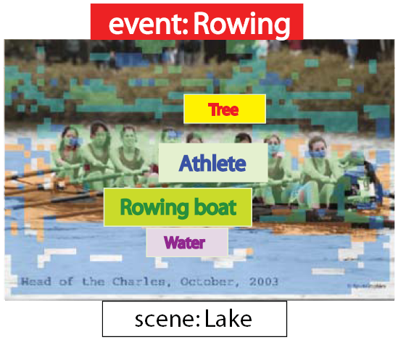
What, where and who? Classifying events by scene and object recognition
L-J Li & L. Fei-Fei, ICCV 2007

Slide 30
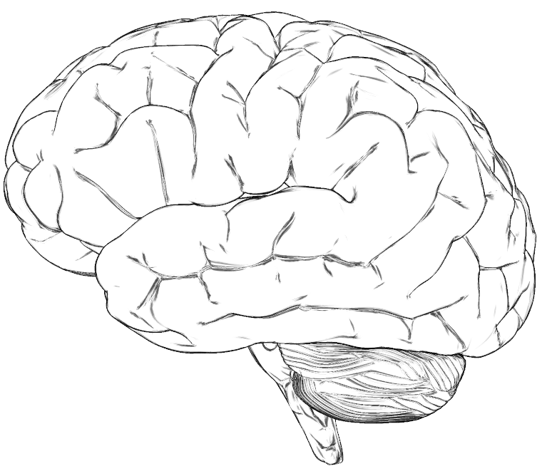
event
PFC
“where” pathway
“what” pathway
scene pathway
object pathway
L.-J. Li & L. Fei-Fei ICCV 2007

Slide 31
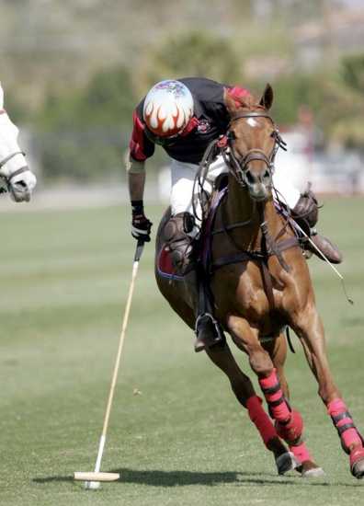










scene pathway
“Polo Field”
Fei-Fei & Perona, CVPR, 2005
L.-J. Li & L. Fei-Fei ICCV 2007

Slide 32
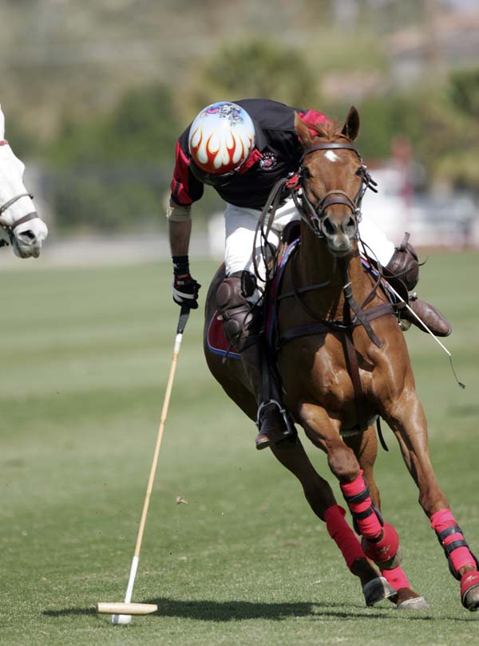











object pathway
O= ‘horse’
G. Wang & L. Fei-Fei, CVPR, 2006
L.-J. Li , G. Wang & L. Fei-Fei, CVPR, 2007
L. Cao & L. Fei-Fei, ICCV, 2007
L.-J. Li & L. Fei-Fei ICCV 2007

Slide 33
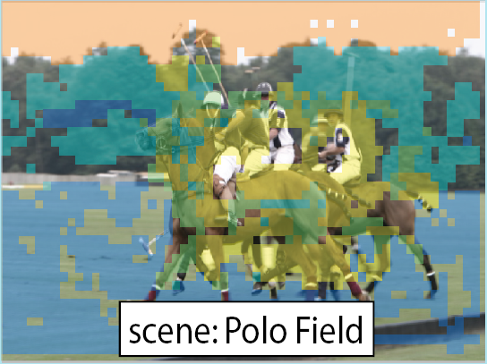
The 3W stories
what
who
where
L.-J. Li & L. Fei-Fei ICCV 2007

Slide 34
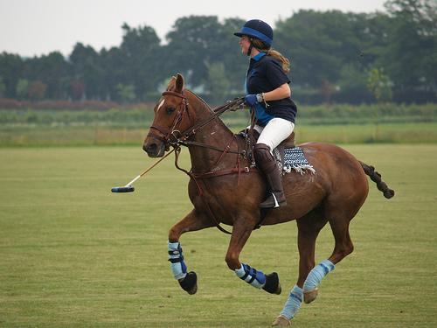


Classification
Annotation
Segmentation
class: Polo
Sky
Tree
Athlete
Athlete
Horse
Grass
Trees
Sky
Saddle
Horse
Horse
Horse
Horse
Horse
Grass
Horse
L-J Li , R. Socher & L. Fei-Fei, CVPR, 2009

Slide 35
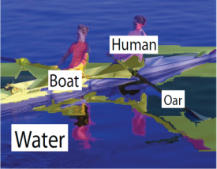




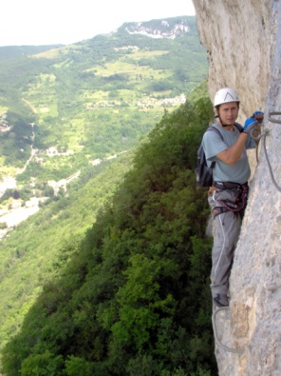
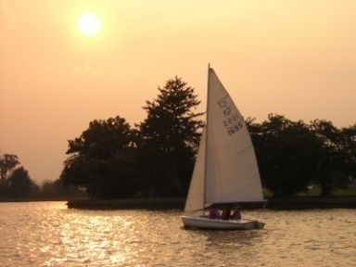

Our model: a hierarchical representation of the image and its semantic contents
Total Scene
Sky
Class: Polo
initialization
Tree
Athlete
Horse
Grass
Trees
Sky
Saddle
Athlete
Horse
Horse
Horse
Horse
Grass
Horse
Generative
Model
…
Sky
Rock
Class:
Rock climbing
noisy images and tags
Mountain
Athlete
Mountain
Trees
Rock
Sky
Ascent
Athlete
Learning
Tree
Class: Sailing
Sky
Athlete
Sailboat
Trees
Water
Sky
Wind
Recognition
Tree
sailboat
Athlete
Water
L-J Li , R. Socher & L. Fei-Fei, CVPR, 2009

Slide 36
Our model: a hierarchical representation of the image and its semantic contents
Total Scene
Sky
Class: Polo
initialization
Tree
Athlete
Horse
Grass
Trees
Sky
Saddle
Athlete
Horse
Horse
Horse
Horse
Grass
Horse
Generative
Model
Generative
Model
…
Sky
Rock
Class:
Rock climbing
noisy images and tags
Mountain
Athlete
Mountain
Trees
Rock
Sky
Ascent
Athlete
Learning
Tree
Class: Sailing
Sky
Athlete
Sailboat
Trees
Water
Sky
Wind
Recognition
Tree
sailboat
Athlete
Water
L-J Li , R. Socher & L. Fei-Fei, CVPR, 2009

Slide 37

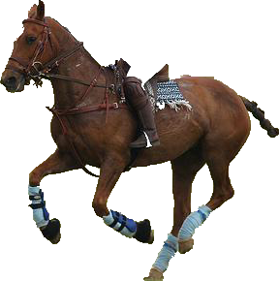
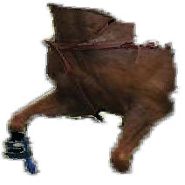

The model: a hierarchical representation of the image and its semantic contents
Total Scene
Polo
C
“Switch variable”
Text
Visible
Not visible
Visual
S
Athlete
Horse
Grass
Trees
Sky
Saddle
horse
Horse
O
T
R
X
Z
NF
Ar
Nr
Nt
“Connector variable”
D

Slide 38
Our model: a hierarchical representation of the image and its semantic contents
Total Scene
Sky
Class: Polo
initialization
initialization
Tree
Athlete
Horse
Grass
Trees
Sky
Saddle
Athlete
Horse
Horse
Horse
Horse
Grass
Horse
Generative
Model
Generative
Model
…
Sky
Rock
Class:
Rock climbing
noisy images and tags
Mountain
Athlete
Mountain
Trees
Rock
Sky
Ascent
Athlete
Learning
Learning
Tree
Class: Sailing
Sky
Athlete
Sailboat
Trees
Water
Sky
Wind
Recognition
Tree
sailboat
Athlete
Water
L-J Li , R. Socher & L. Fei-Fei, CVPR, 2009

Slide 39

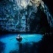
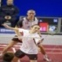
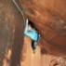
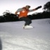
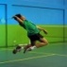
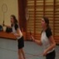
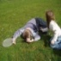
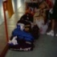
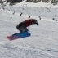
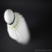
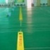
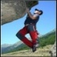




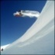
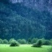










Need some good, initial “guestimate” of O
Total Scene
Scene/Event images
from the Internet
C
S
O
T
R
X
Z
NF
Ar
Nr
Nt
L-J Li , R. Socher & L. Fei-Fei, CVPR, 2009

Slide 40


Auto-semi-supervised learning:
Small # of initialized images + Large # of uninitialized images
Total Scene
Scene/Event images
from the Internet
Athlete
Horse
Generative
Model
Grass
Tree
Wind
Saddle
Large # of uninitialized images
+
Small # of initialized images
L-J Li , R. Socher & L. Fei-Fei, CVPR, 2009

Slide 41
Our model: a hierarchical representation of the image and its semantic contents
Total Scene
Sky
Class: Polo
initialization
Tree
Athlete
Horse
Grass
Trees
Sky
Saddle
Athlete
Horse
Horse
Horse
Horse
Grass
Horse
Generative
Model
…
Sky
Rock
Class:
Rock climbing
noisy images and tags
Mountain
Athlete
Mountain
Trees
Rock
Sky
Ascent
Athlete
Learning
Tree
Class: Sailing
Sky
Athlete
Sailboat
Trees
Water
Sky
Wind
Recognition
Tree
sailboat
Athlete
Water
L-J Li , R. Socher & L. Fei-Fei, CVPR, 2009

Slide 42
















8 Event/Scene Classes
Rock climbing
Badminton
Bocce
Rowing
Croquet
Sailing
Snow
boarding
Polo

Slide 43








Some sample results
Total Scene
Class: Croquet
Class: Bocce
Class: Snowboarding
Class: Polo
Class: Sailing
Class: Badminton
Class: Rock Climbing
Class: Rowing
L-J Li , R. Socher & L. Fei-Fei, CVPR, 2009

Slide 44
PT = 27ms
This was a picture with some dark sploches in it. Yeah. . .that's about it. (Subject: KM)
PT = 40ms
I think I saw two people on a field. (Subject:
RW)
PT = 67ms
Outdoor scene. There were some kind of animals, maybe dogs or horses, in the middle of the picture. It looked like they were running in the middle of a grassy field. (Subject: IV)
PT = 500ms
Some kind of game or fight. Two groups of two men? The foregound pair looked like one was getting a fist in the face. Outdoors seemed like because i have an impression of grass and maybe lines on the grass? That would be why I think perhaps a game, rough game though, more like rugby than football because they pairs weren't in pads and helmets, though I did get the impression of similar clothing. maybe some trees? in the background. (Subject: SM)
PT = 107ms
two people, whose profile was toward me. looked like they were on a field of some sort and engaged in some sort of sport (their attire suggested soccer, but it looked like there was too much contact for that). (Subject: AI)
Fei-Fei, Iyer, Koch, Perona, JoV, 2007

